Slide 1

The implications of picking A FSM over microstore
Electrical Engineering, EEMCS
Joost Buursink Fabian Widlund Emil Imhagen
Guus branderhorst
Stach Redeker Group 7

Slide 2
Our presentation is a little bit different

Slide 3
FSM? Microstore?
Let’s summarize quickly

Slide 4
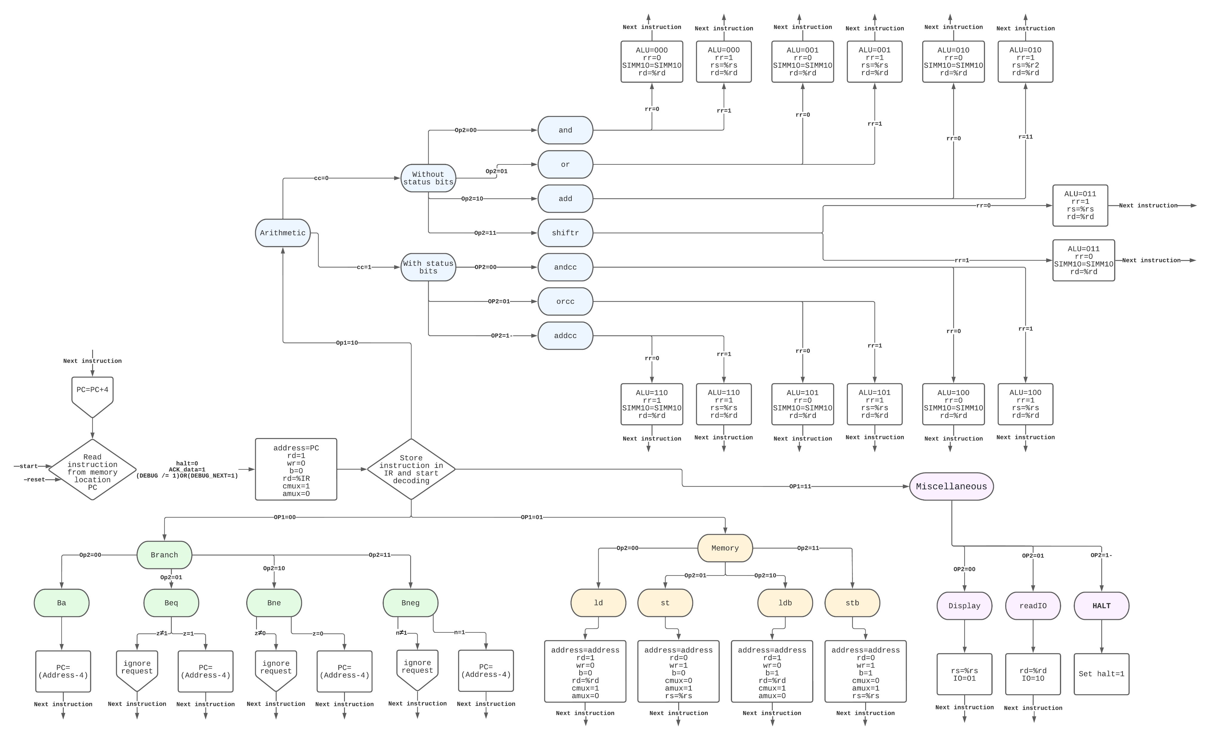
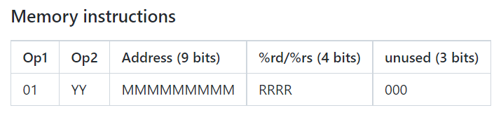
Finite state machine (fsm)

Slide 5
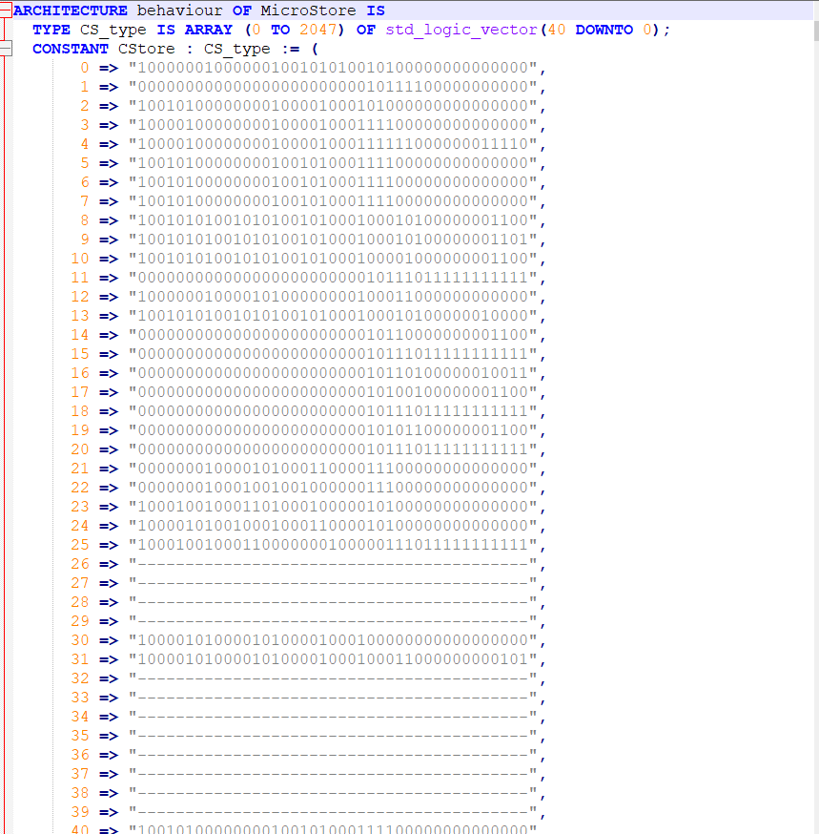
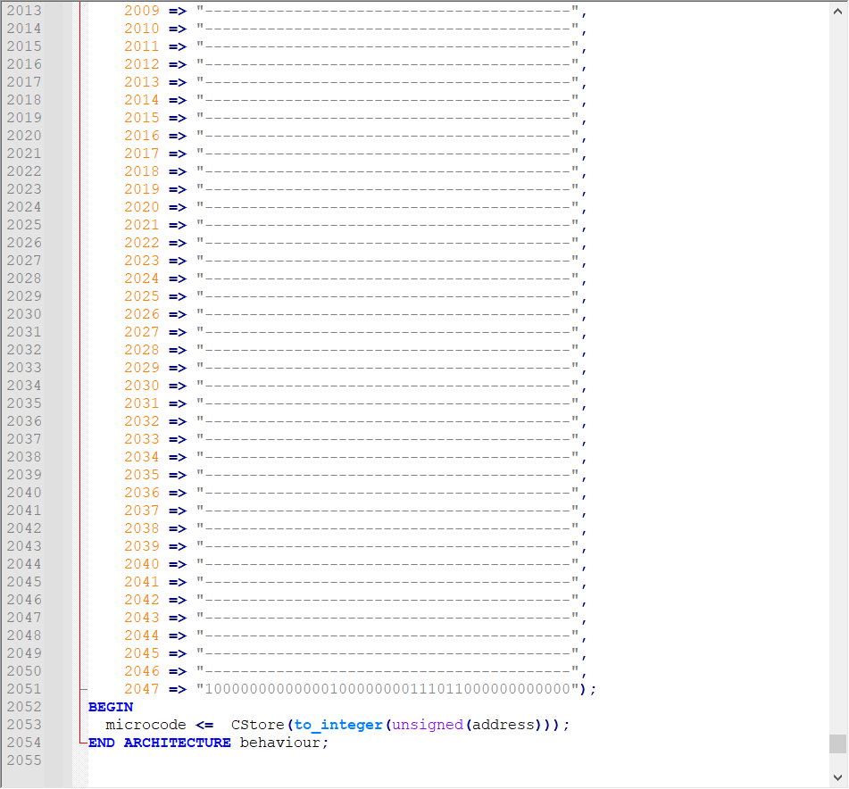

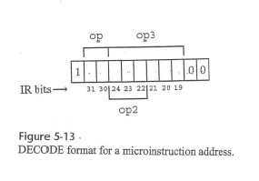
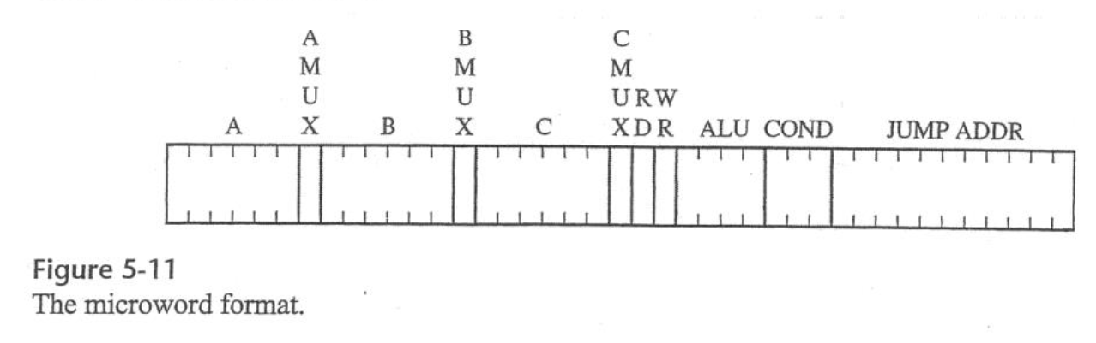
Microstore

Slide 6
Our hypothesis
FSM Microstore
Quite elegant for small instruction sets
Human readable
Can get quite large
Scales better for larger instruction sets
Not human readable
Requires a large LUT small instruction sets

Slide 7
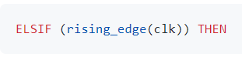
The implications of using a FSM

Slide 8
The implications of using a FSM

Slide 9
The implications of using a FSM

Slide 10
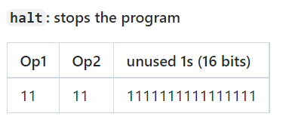
How do WE halt?

Slide 11
How do WE halt?
Just stopping the program counter doesn’t work

Slide 12
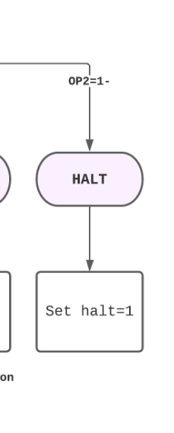
How do WE halt?
Most efficient solution? Stop the controller!

Slide 13
How do WE halt?
Most efficient solution? Stop the controller!

Slide 14
Halting in microstore?

Slide 15
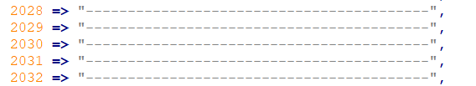
Halting in microstore?
Jump to an empty location. Problem solved.

Slide 16
The implications of using a FSM

Slide 17
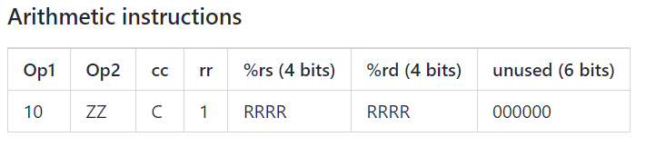
How do we know that the datapath is ready?
The datapath/ALU/memory may need more than one clock cycle to get an instruction done

Slide 18
How do we know that the datapath is ready?
The datapath/ALU/memory may need more than one clock cycle to get an instruction done
If the controller keeps pushing instructions -> problem!

Slide 19
First solution: can we get every operation done in one cycle?

Slide 20
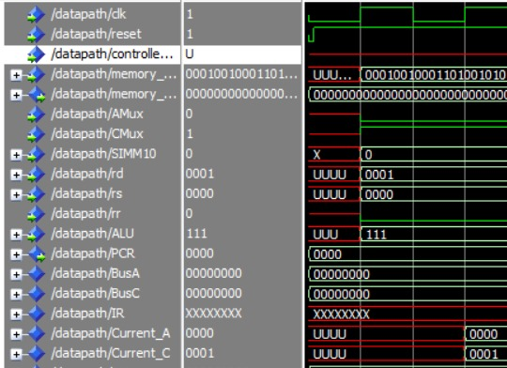
First solution: can we get every operation done in one cycle?
Metastability

Slide 21
First solution: can we get every operation done in one cycle?
Metastability

Slide 22
SECOND solution: can the contents of the fsm change?
No, because loops (counters) in a FSM are unwanted
And it would mess with our PC

Slide 23
So, we need to able able to cope with multiple clock cycles
How?

Slide 24
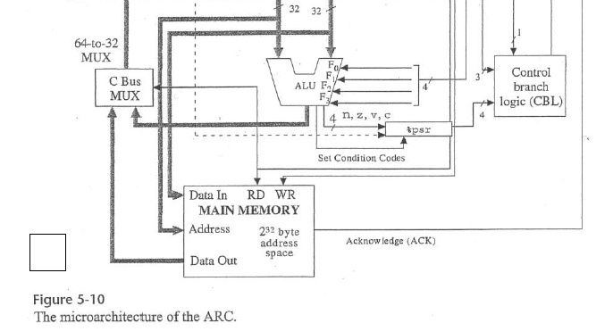
So, we need to able able to cope with multiple clock cycles
How?

Slide 25
So, we need to able able to cope with multiple clock cycles
What does ARC?

Slide 26
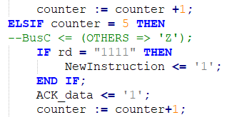
Acknowledge!

Slide 27
Acknowledge!

Slide 28
How does microstore know that the datapath is ready?

Slide 29
How does microstore know that the datapath is ready?
It’s natively baked in.

Slide 30
DEBUG MODE
Requirements
Load the contents of a memory address and display it using the seven-segment displays

Slide 31
Debug mode
2 new signals added to the controller allowing the DEBUG to step through the code 1 line at a time.
”DEBUG” is 1 if the debug switch is turned on.
”DEBUG_NEXT” is 1 for exactly 1 clock cycle when a user presses the 'next line' button.

Slide 32
Debug mode
How can we set ”DEBUG_NEXT” to 1 for exactly 1 clock cycle => ”Debugging_Facilitators”
It handles the input and transforms it to the required signal
”Debugging_Display”
Debug harder to realize with microstore

Slide 33
Debug mode in microstore
Harder to realize with microstore instructions

